Slide 1
EXPLORING LONDON CITY VENUES
NICOLA CROON

Slide 2
BACKGROUND
DESTINATION OF THE ANALYSIS
LONDON CITY
AREA DIMENSION
1569 KM^2
TOTAL WARDS
25
DATA – CSV FILE
https://www.doogal.co.uk/AdministrativeAreas.php?district=E09000001

Slide 3
PROBLEM AND METHODOLOGY
METHODOLOGY
FOURSQUARE API TO GET VENUES OF THE WARDS
PROBLEM
IS IT CONVENIENT TO OPEN A PIZZA PLACE IN LONDON CITY?
METRIC OF DECISION
CONCENTRATION OF COMPETITION OF PIZZA PLACES AND ITALIAN RESTAURANTS IN EACH WARD

Slide 4
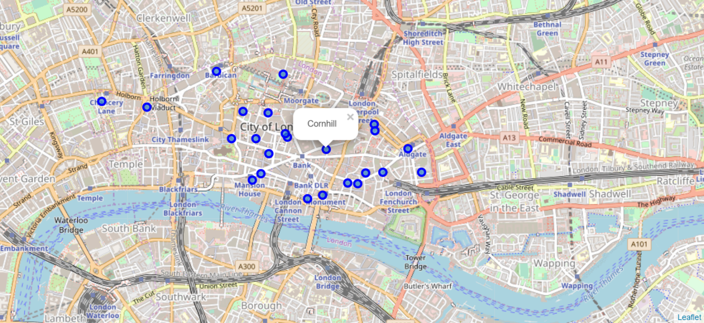
EXPLORATORY DATA ANALYSIS

Slide 5
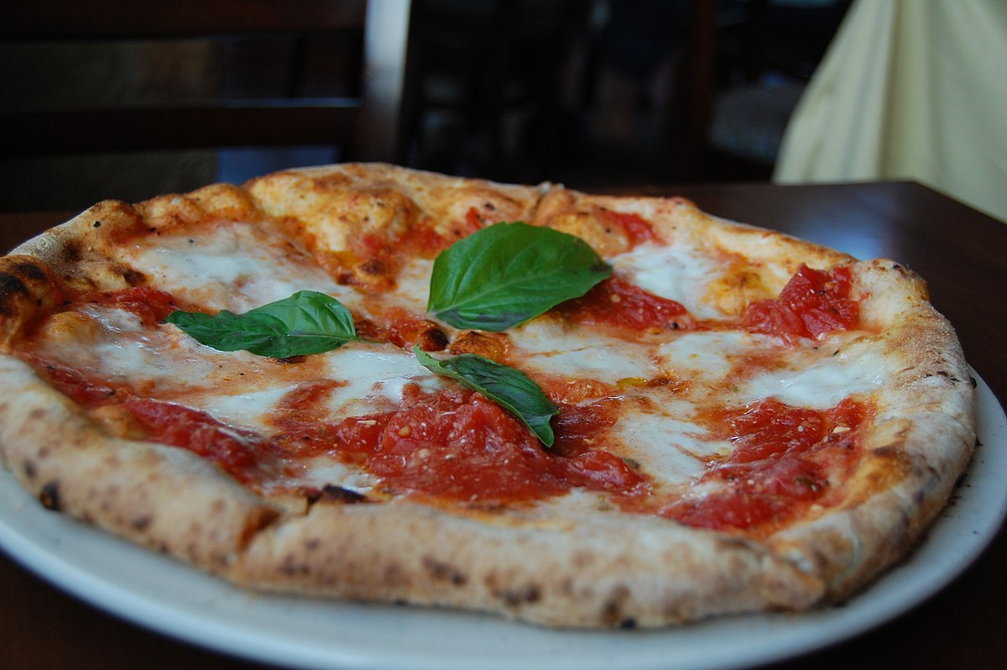
EXPLORATORY DATA ANALYSIS
SOME INSIGHTS
- NUMBER OF PIZZA PLACES NOT SO HIGH
HIGH NUMBER OF ITALIAN RESTAURANTS
HIGHEST NUMBER OF COFEE SHOPS

Slide 6
MODELING AND METHODOLOGY
FOURSQUARE API
TO COLLECT THE VENUES
UNSUPERVISED LEARNING METHOD
K-MEANS CLUSTERING
GOAL TO FIND THE MOST SUITABLE CLUSTER – THE ONE WITH THE HIGHEST CONCENTRATION OF COMPETITORS
THREE CLUSTERS BECAUSE OF THE DIMENSION OF THE AREA
PLOTS
FOLIUM - FOR GEORAPHICAL PLOTS

Slide 7
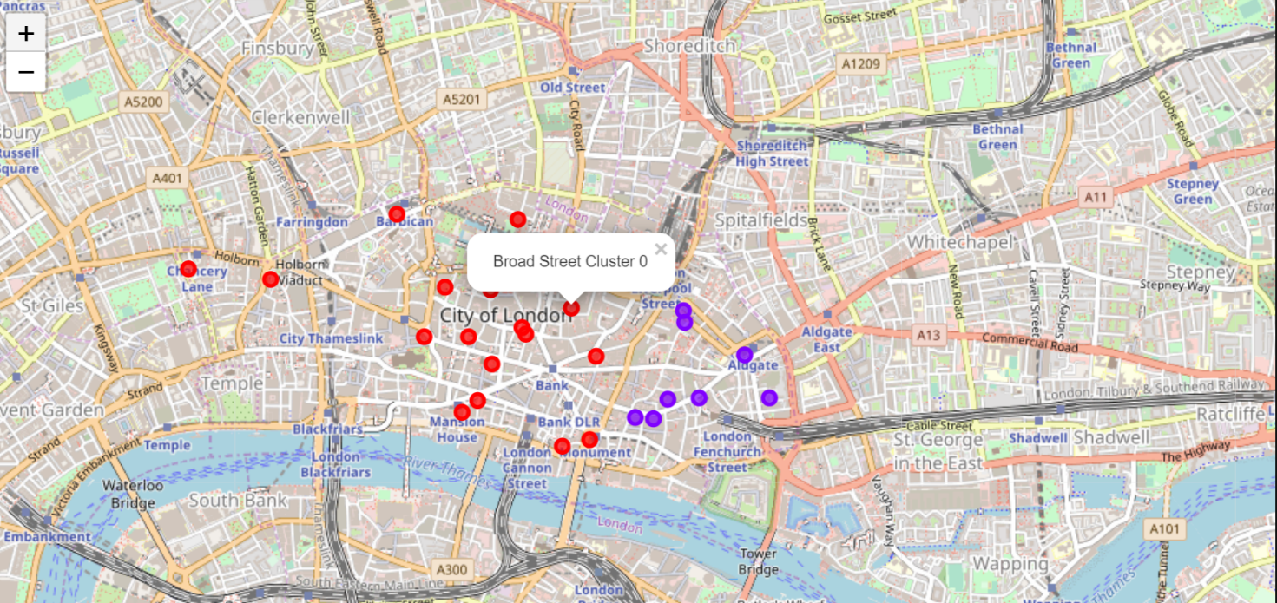
RESULTS

Slide 8
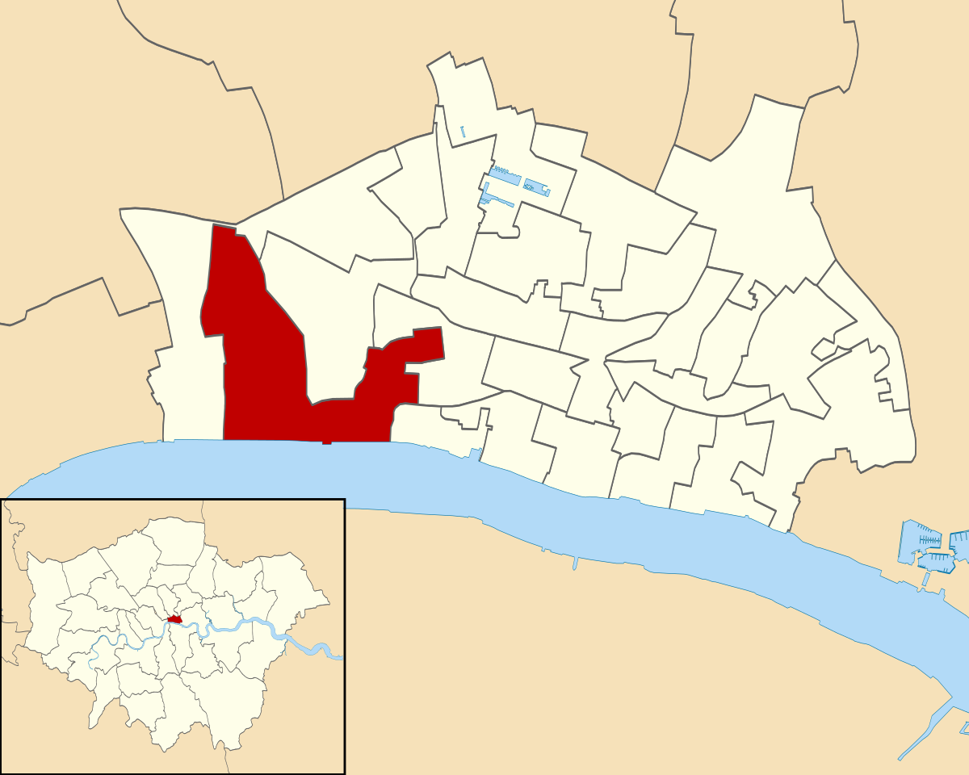
RESULTS
WHICH ONE
MOST SUITABLE CLUSTER IS CLUSTER NUMBER ZERO
WHY
HIGH CONCENTRATION OF ITALIAN RESTAURANTS AND PIZZA PLACES

Slide 9
CONCLUSIONS
SELECTED WARDS:
VINTRY
BREAD STREET
QUEENHITHE
WALBROOK
CORDWAINER
COLEMAN STREET
ALDERSGATE
BASSISHAW
CHEAP

